Slide 1
1.2
Introduction

Slide 2
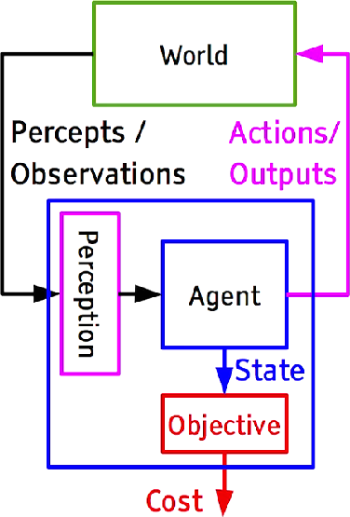
Artificial Intelligence
“An attempt will be made to find how to make machines use language, form abstractions and concepts, solve kinds of problems now reserved for humans, and improve themselves.” [John McCarthy]
Machine Learning
Computer Vision
Computer Graphics
Natural Language Processing
Robotics & Control
Art, Industry 4.0, Education ...
19

Slide 3
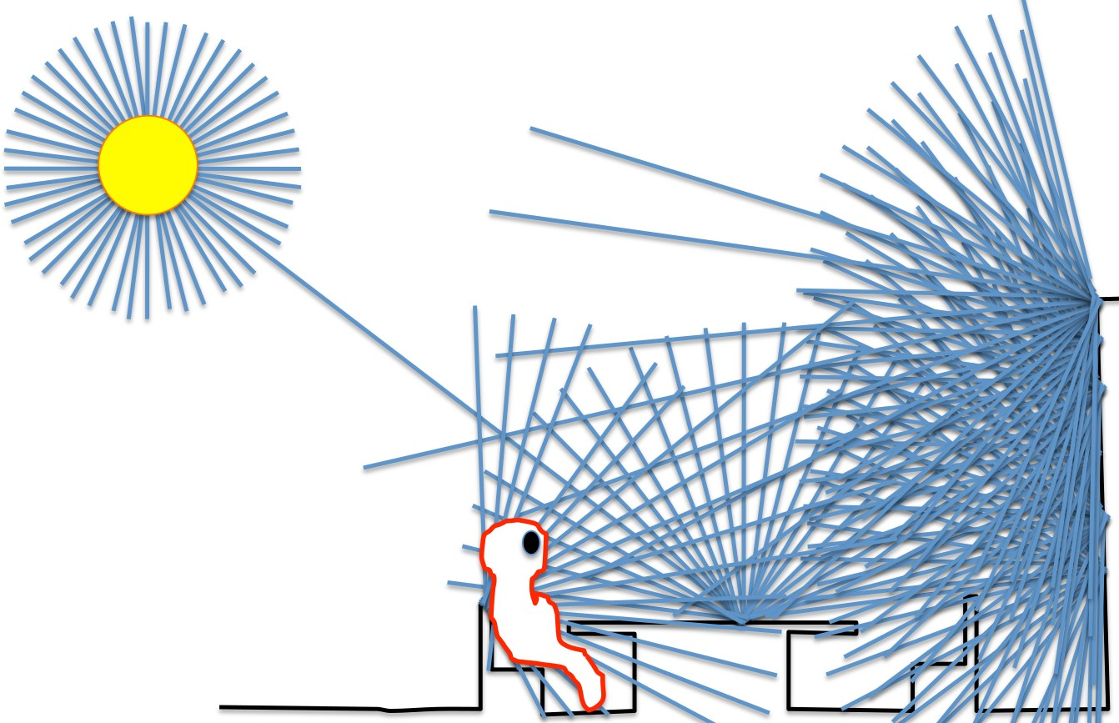
Computer Vision
Goal of Computer Vision is to convert light into meaning (geometric, semantic, . . . )
Image Credits: Antonio Torralba
20

Slide 4
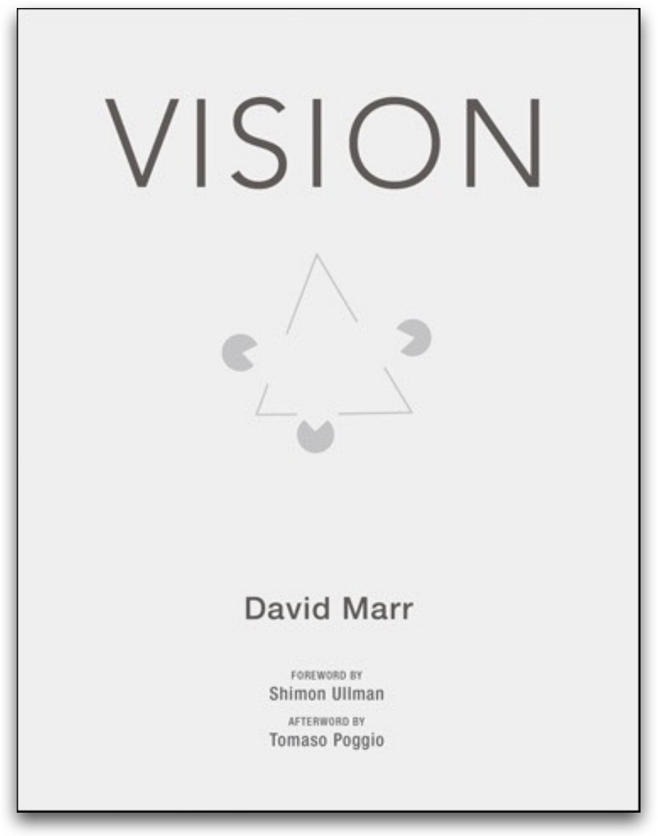
Computer Vision
What does it mean, to see? The plain man’s answer (and Aristotle’s, too) would be, to know what is where by looking.
To discover from images what is present in the world, where things are, what actions are taking place, to predict and anticipate events in the world.
Slide Credit: Torralba, Freeman, Isola

Slide 5
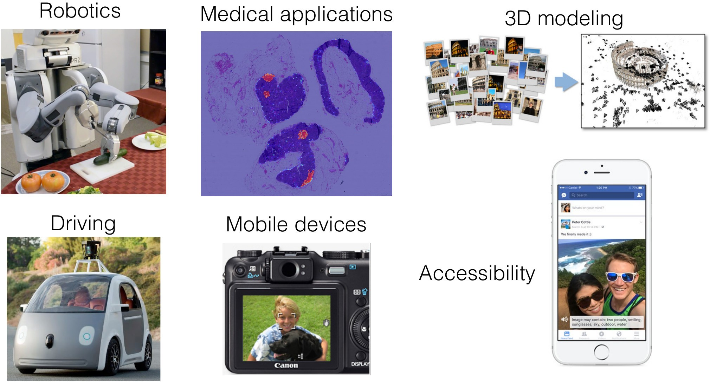
Computer Vision Applications
Slide Credit: Torralba, Freeman, Isola

Slide 6
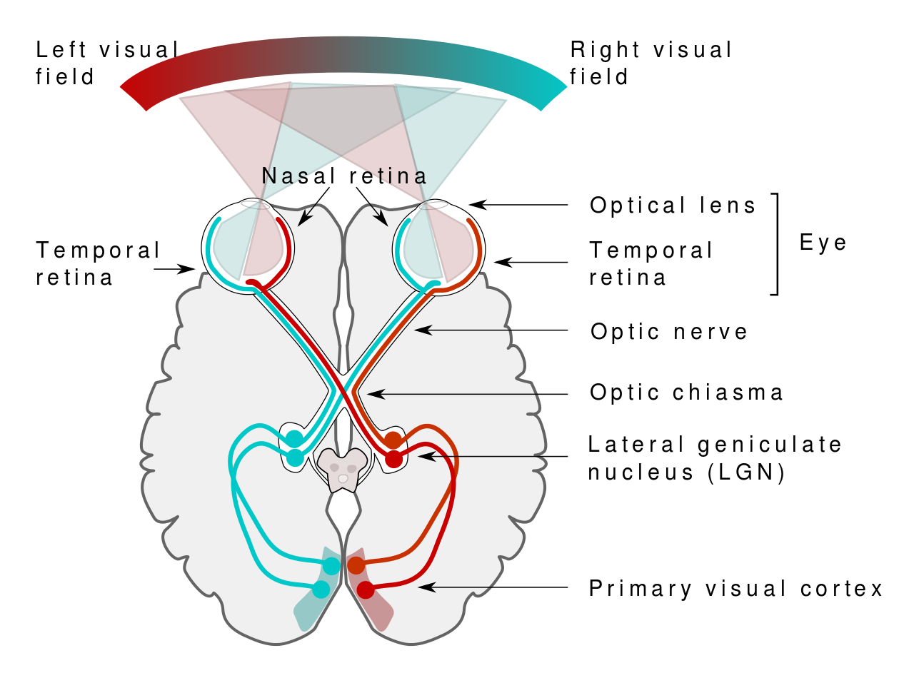
Computer Vision vs. Biological Vision
Over 50% of the processing in the human brain is dedicated to visual information.

Slide 7
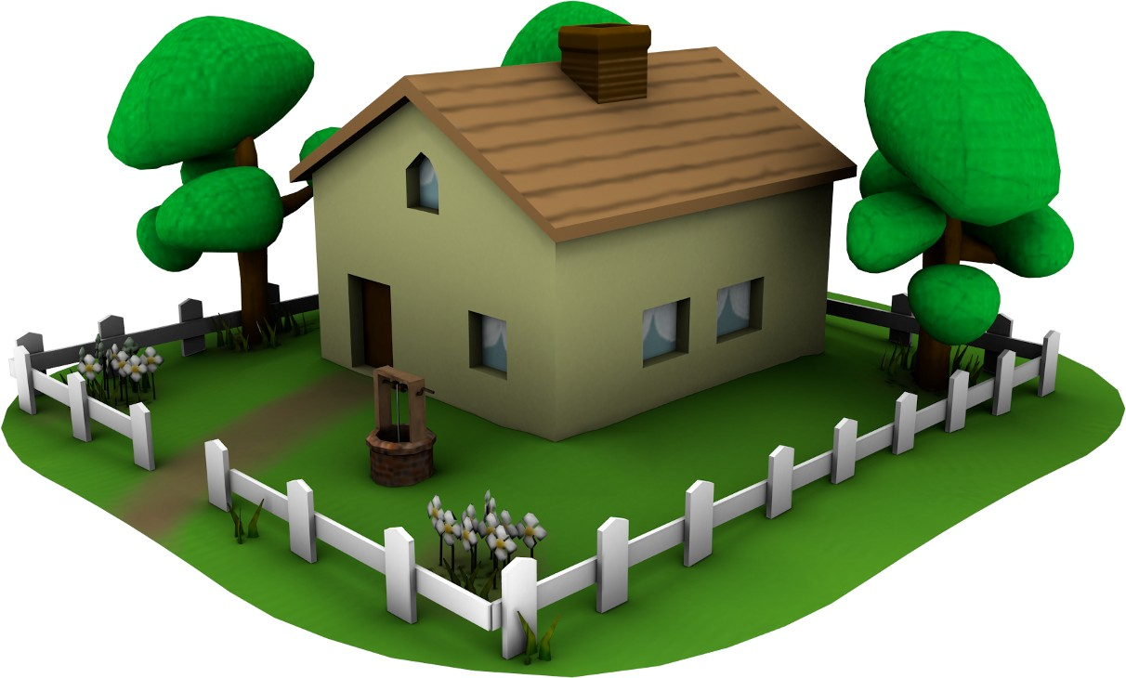

Computer Vision vs. Computer Graphics
2D Image
3D Scene
Graphics
Vision
Pixel Matrix
Objects Shape/Geometry Semantics
Material Motion 3D Pose
217 | 191 | 252 | 255 | 239
102 | 80 | 200 | 146 | 138
159 | 94 | 91 | 121 | 138
179 | 106 | 136 | 85 | 41
115 | 129 | 83 | 112 | 67
94 | 114 | 105 | 111 | 89
24

Slide 8
Computer Vision vs. Computer Graphics
2D Image
3D Scene
Graphics
Vision
Computer Vision is an ill-posed inverse problem:
Many 3D scenes yield the same 2D image
Additional constraints (knowledge about world) required
24

Slide 9
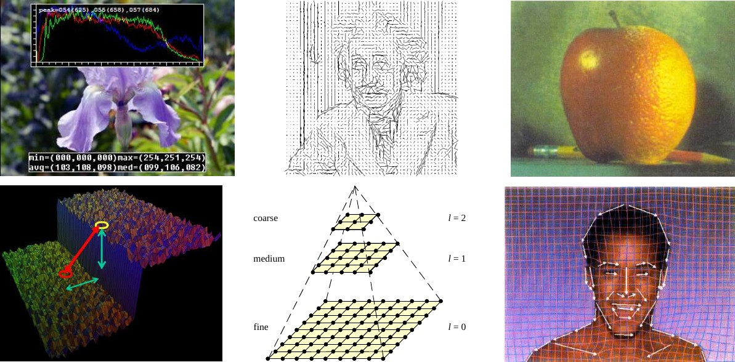
Computer Vision vs. Image Processing
Slide Credits: Rick Szeliski
25

Slide 10
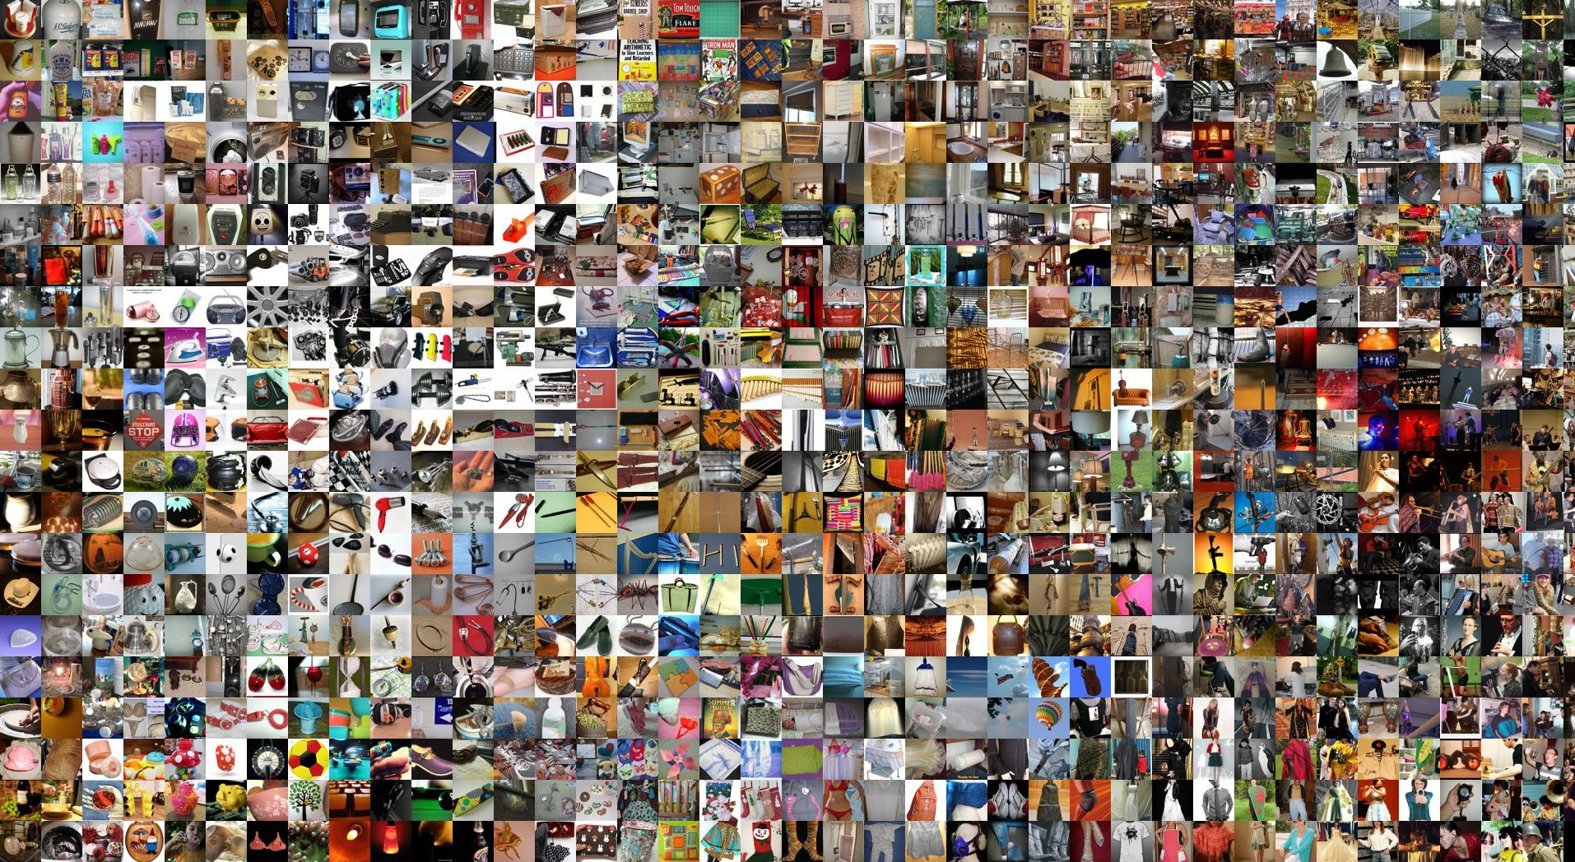
Computer Vision vs. Machine Learning
Deng, Dong, Socher, Li, Li and Li: ImageNet: A large-scale hierarchical image database. CVPR, 2009.
26

Slide 11
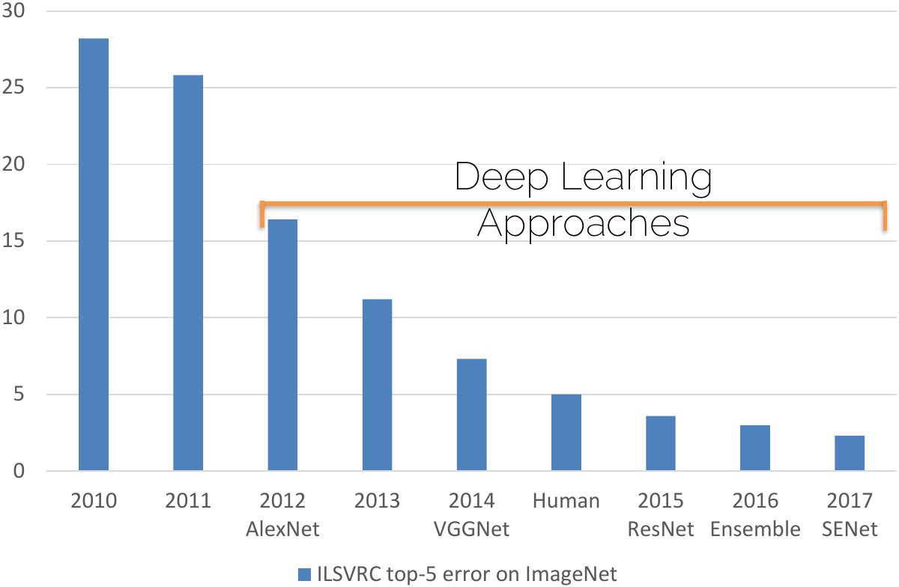
The Deep Learning Revolution
Slide Credit: Matthias Niessner
27

Slide 12
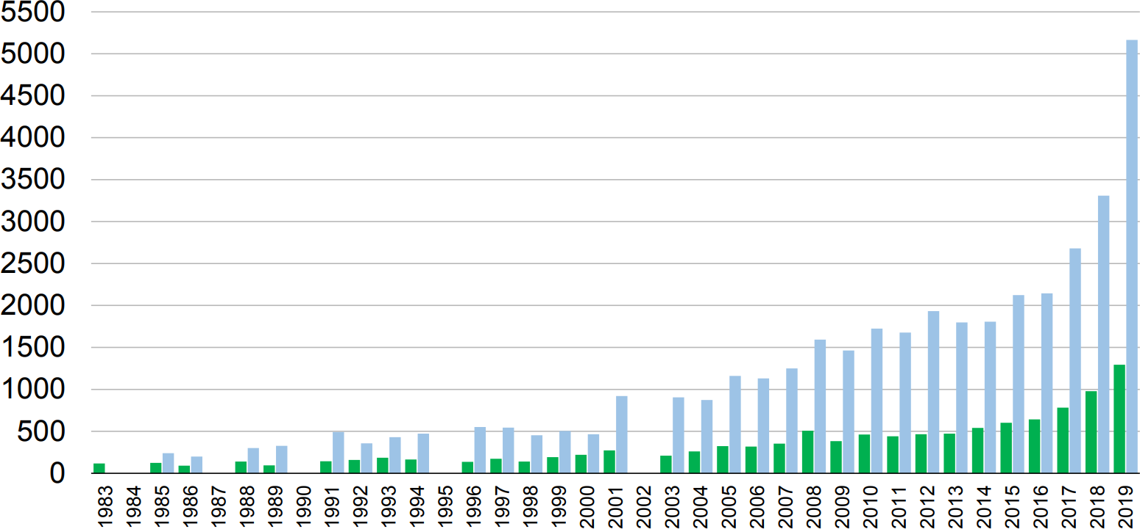
CVPR Submitted and Accepted Papers
Slide Credit: CVPR 2019 Welcome Slides

Slide 13
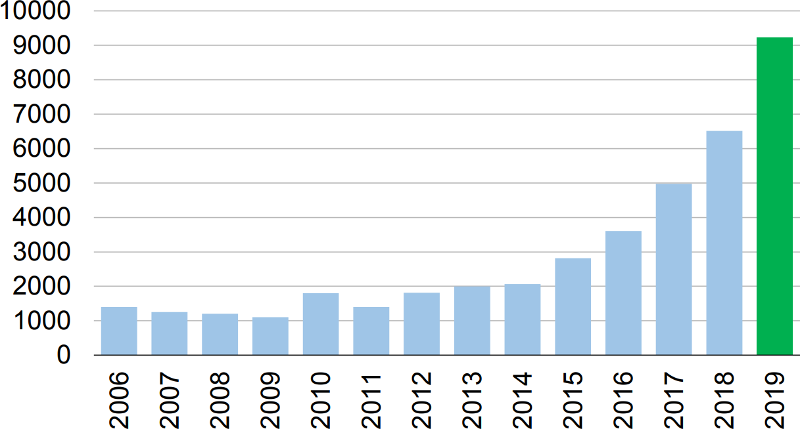
CVPR Attendance
Slide Credit: CVPR 2019 Welcome Slides

Slide 14
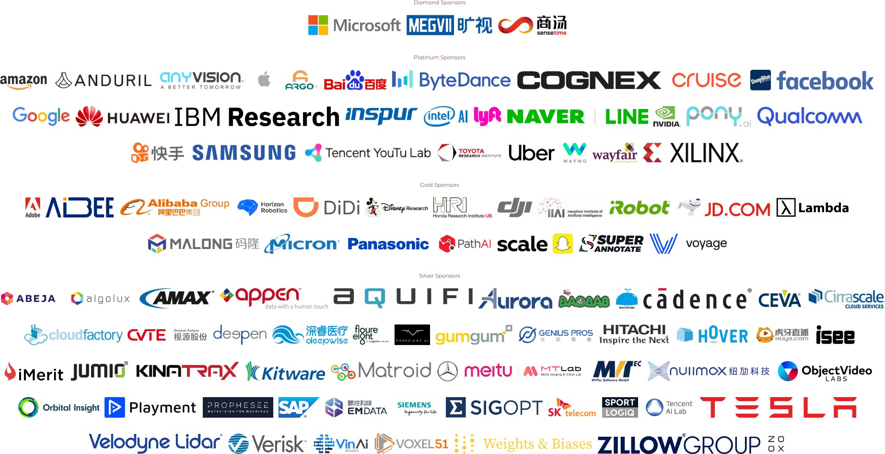
CVPR 2019 Sponsors
Slide Credit: CVPR 2019 Welcome Slides

Slide 15
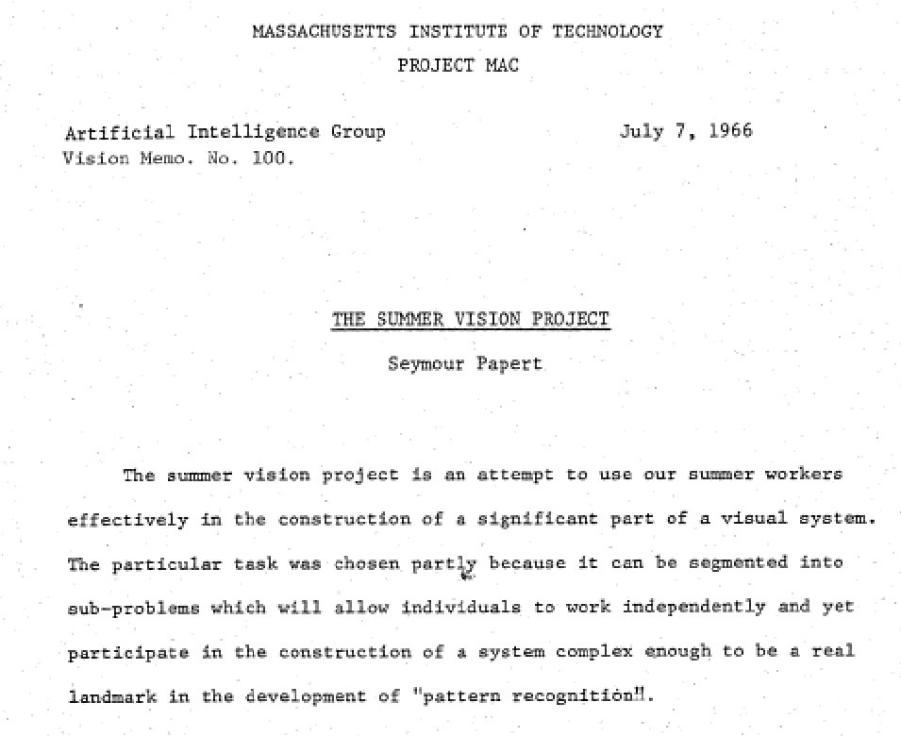
Why is Visual Perception hard?
Papert: The Summer Vision Project. MIT AI Memos, 1966.

Slide 16
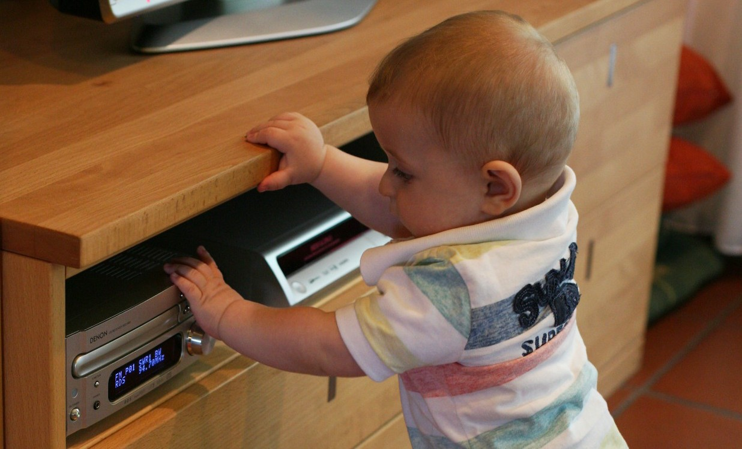
Why is Visual Perception hard?

Slide 17
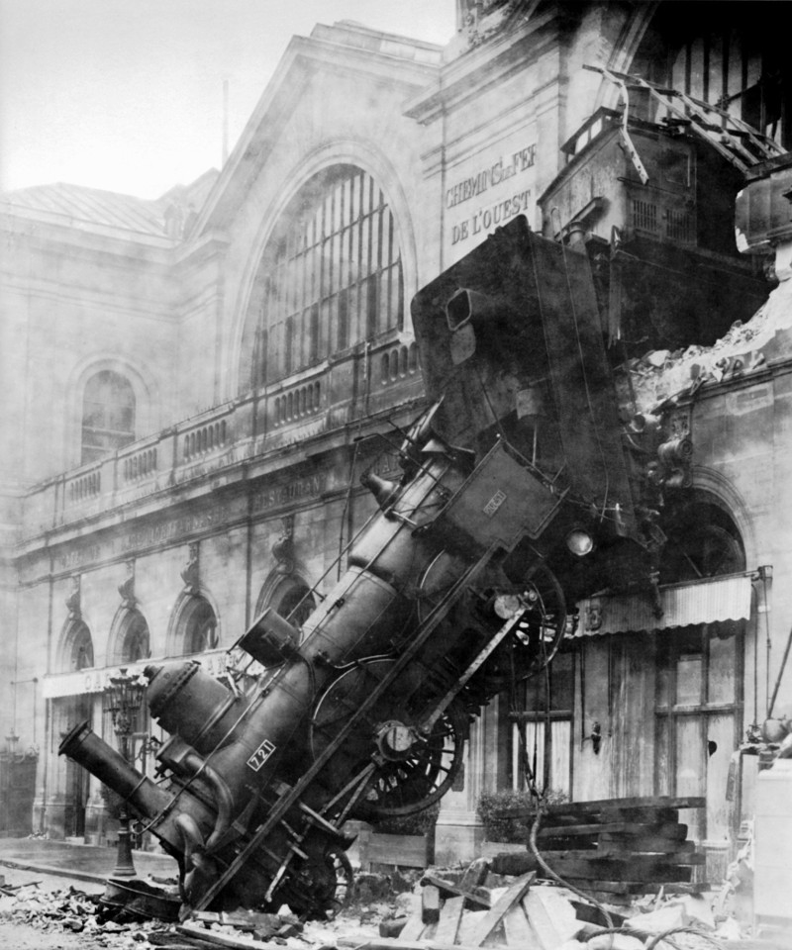
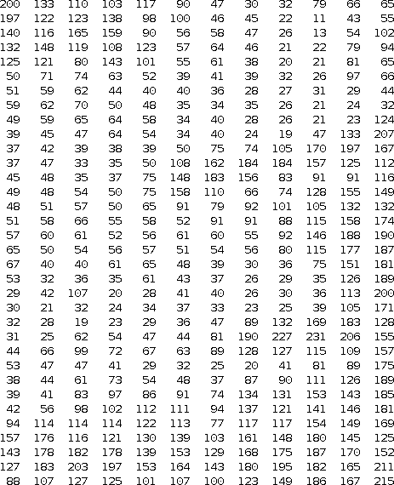
Why is Visual Perception hard?
What we see
What the computer sees
Slide Credits: Li Fei-Fei
33

Slide 18
Challenges: Images are 2D Projections of the 3D World
2D Image 3D Scene
Graphics
Vision
34

Slide 19
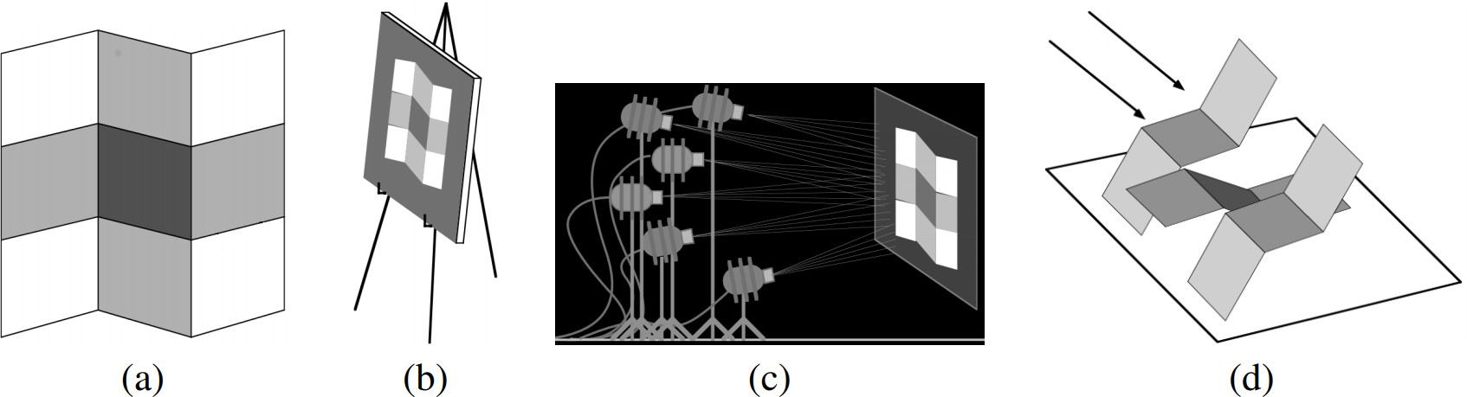
Challenges: Images are 2D Projections of the 3D World
Adelson and Pentland’s workshop metaphor:
To explain an image (a) in terms of reflectance, lighting and shape, (b) a painter, (c) a light designer and (d) a sculptor will design three different, but plausible, solutions.
Adelson and Pentland: The perception of shading and reflectance. Perception as Bayesian inference, 1996.
35

Slide 20
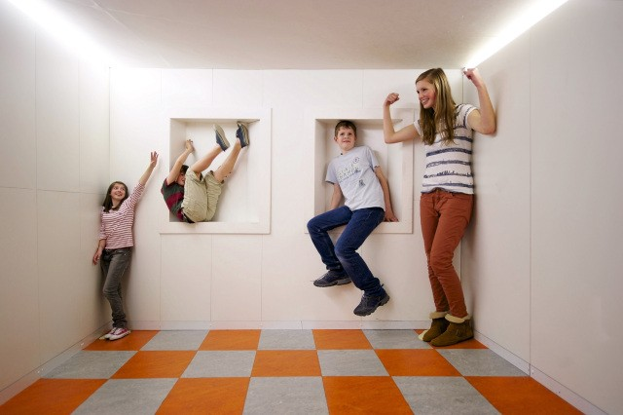
Ames Room Illusion

Slide 21
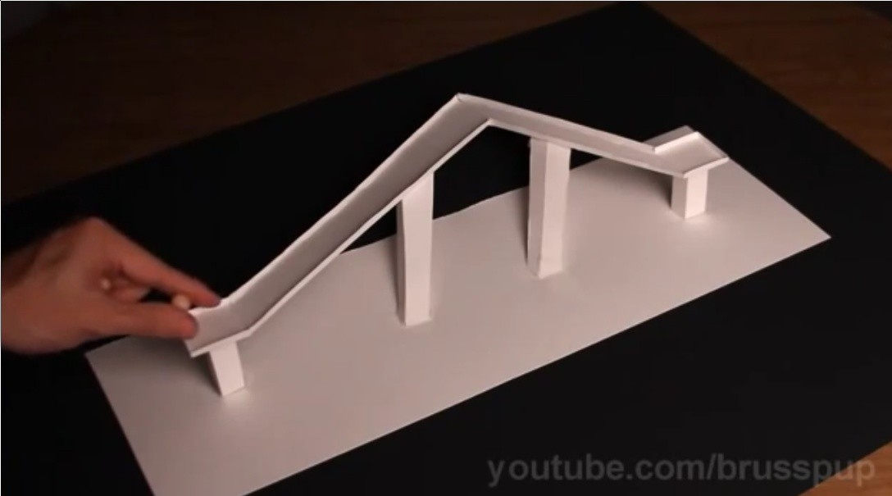
Perspective Illusion

Slide 22
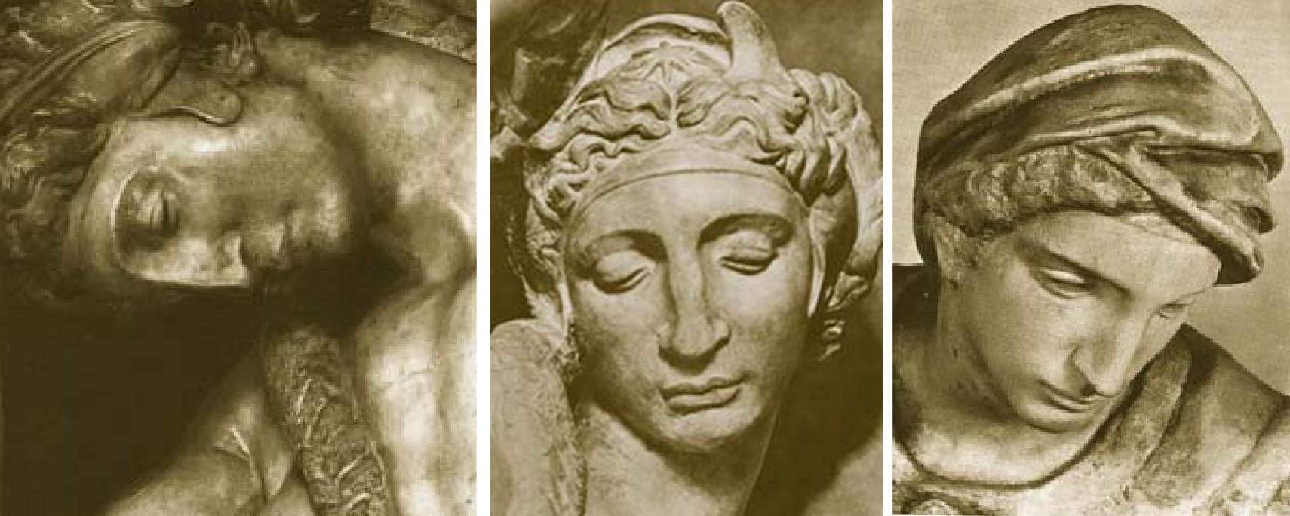
Challenges: Viewpoint Variation
Michelangelo (1475-1564)

Slide 23
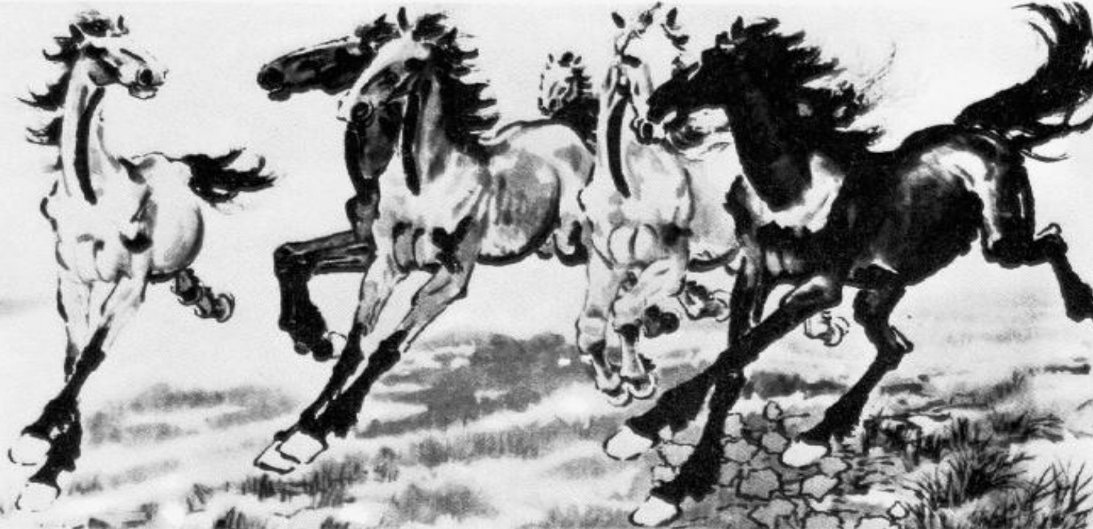
Challenges: Deformation
Xu Beihong (1943)

Slide 24
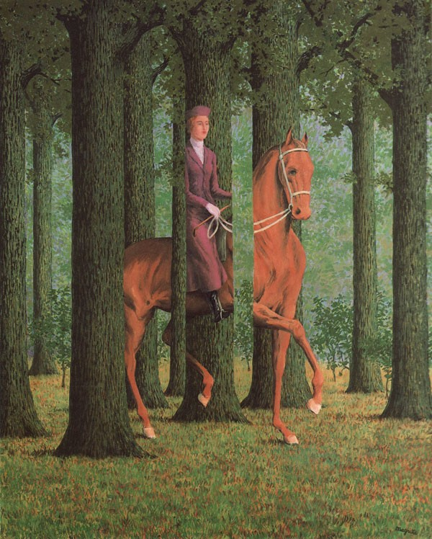
Challenges: Occlusion
Rene´ Magritte (1957)

Slide 25
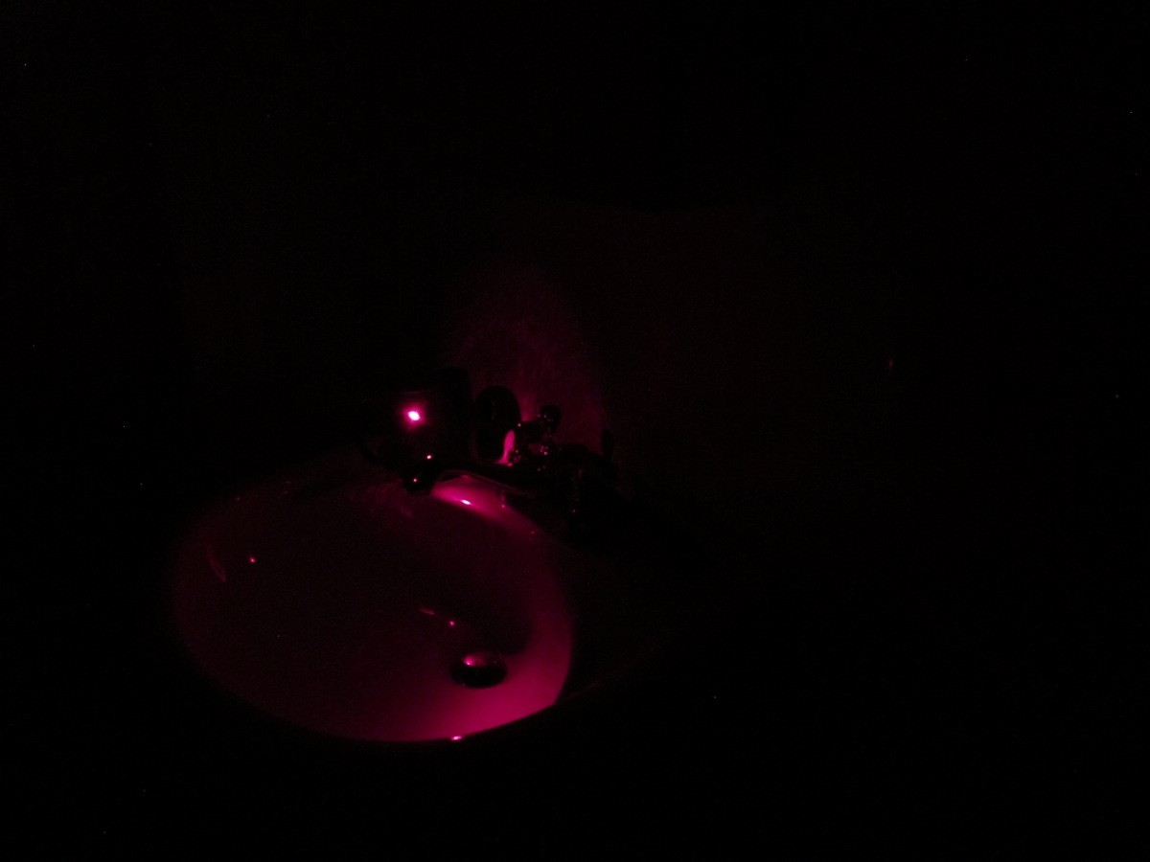
Challenges: Illumination
Slide Credits: Antonio Torralba
41

Slide 26
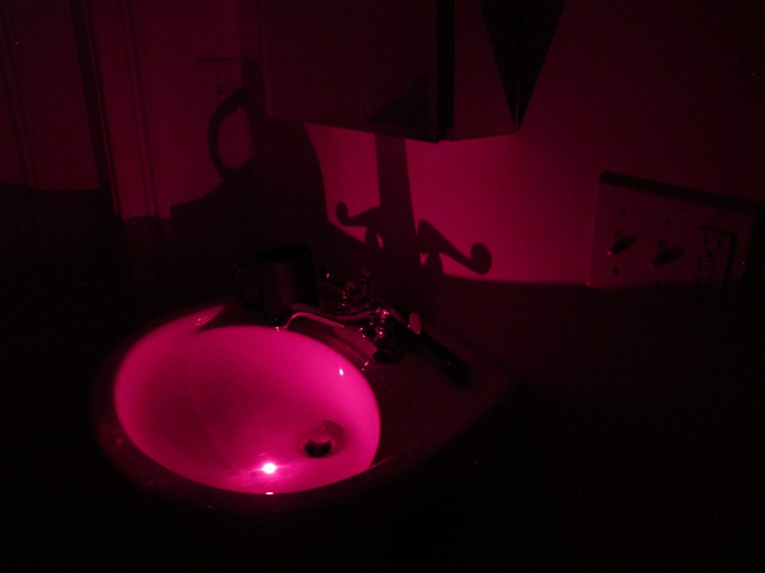
Challenges: Illumination
Slide Credits: Antonio Torralba
41

Slide 27
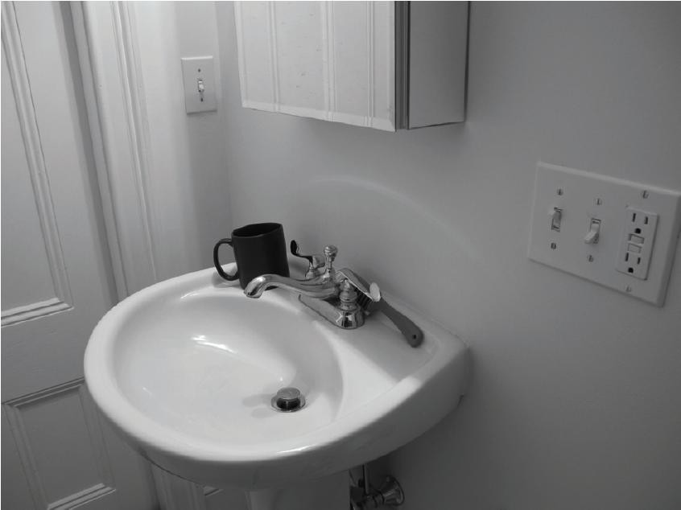
Challenges: Illumination
Slide Credits: Antonio Torralba
41

Slide 28
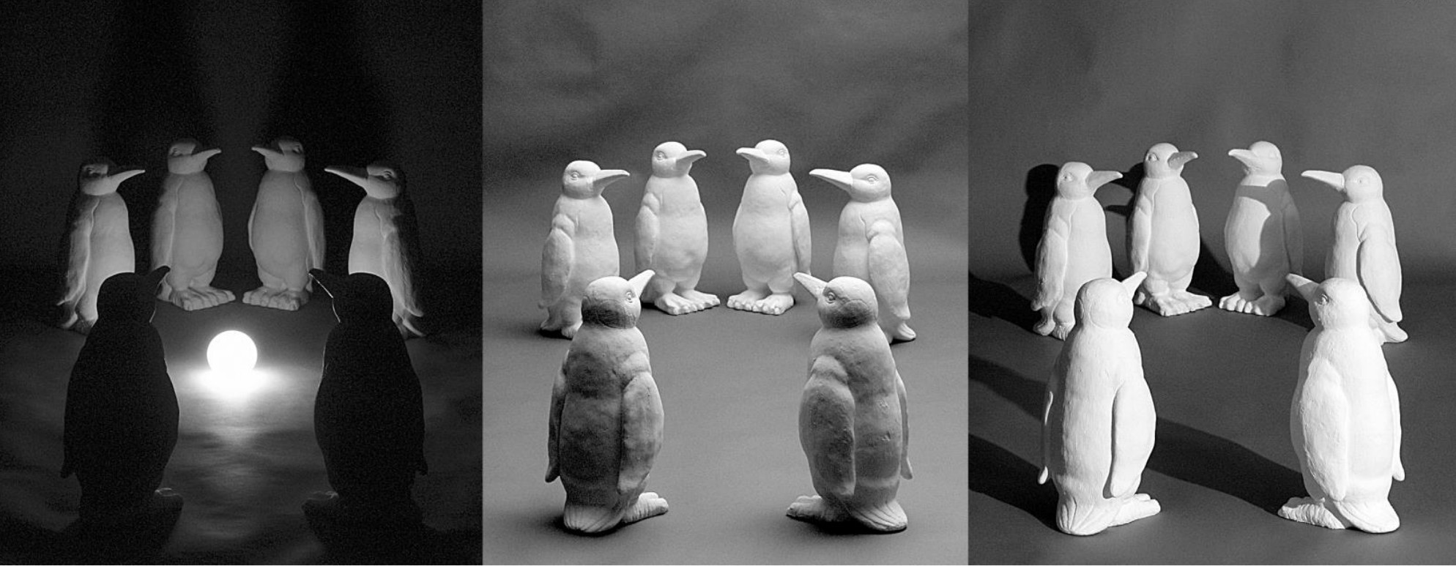
Challenges: Illumination
Image Credits: Jan Koenderink
42

Slide 29
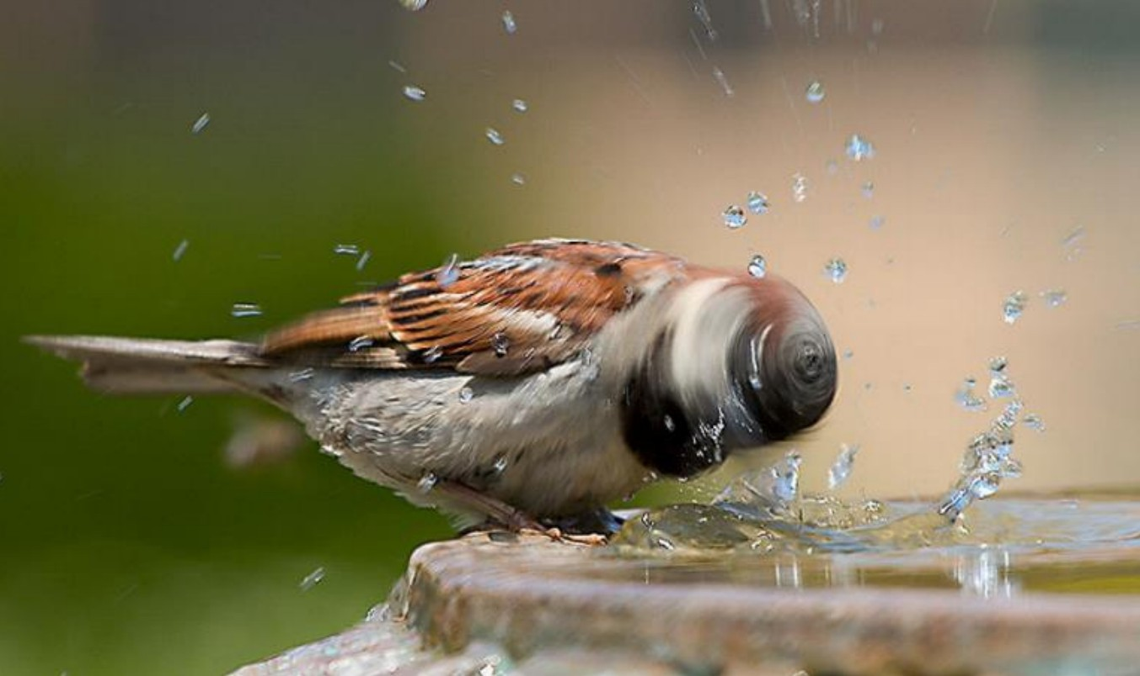
Challenges: Motion
43

Slide 30
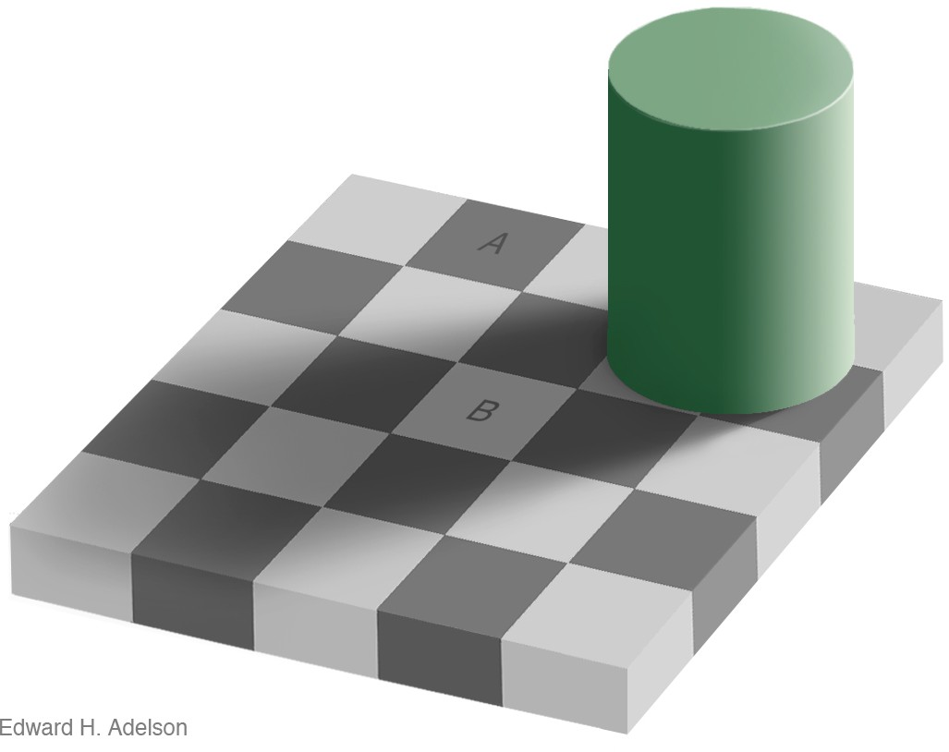

Challenges: Perception vs. Measurement
http://persci.mit.edu/gallery/checkershadow
Image Credits: Edward H. Adelson
44

Slide 31
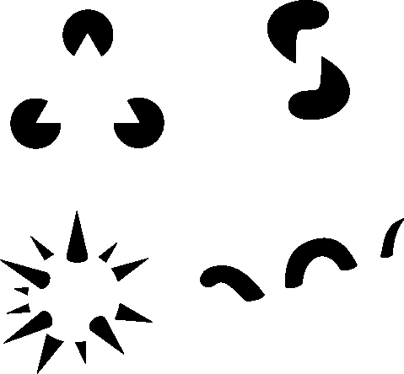
Challenges: Perception vs. Measurement
Gaetano Kanizsa (1976)
45

Slide 32
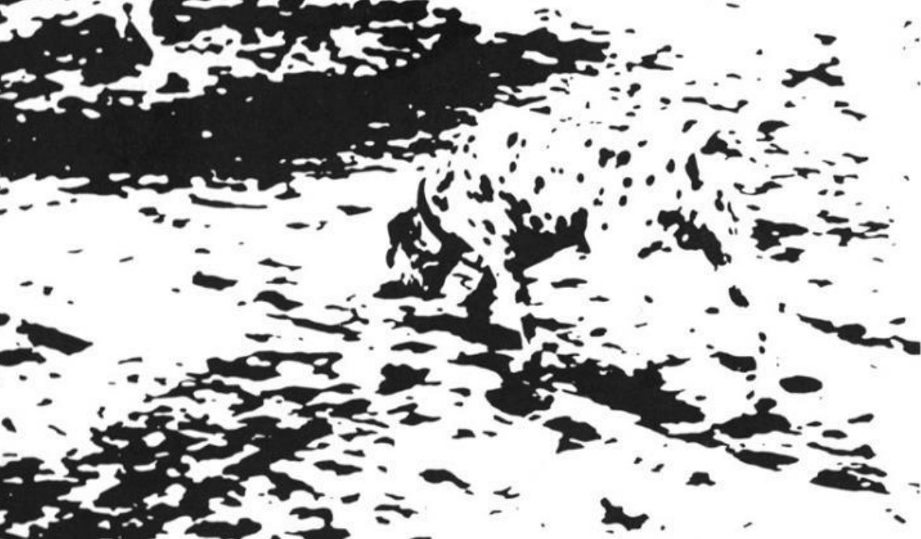
Challenges: Perception vs. Measurement
46

Slide 33
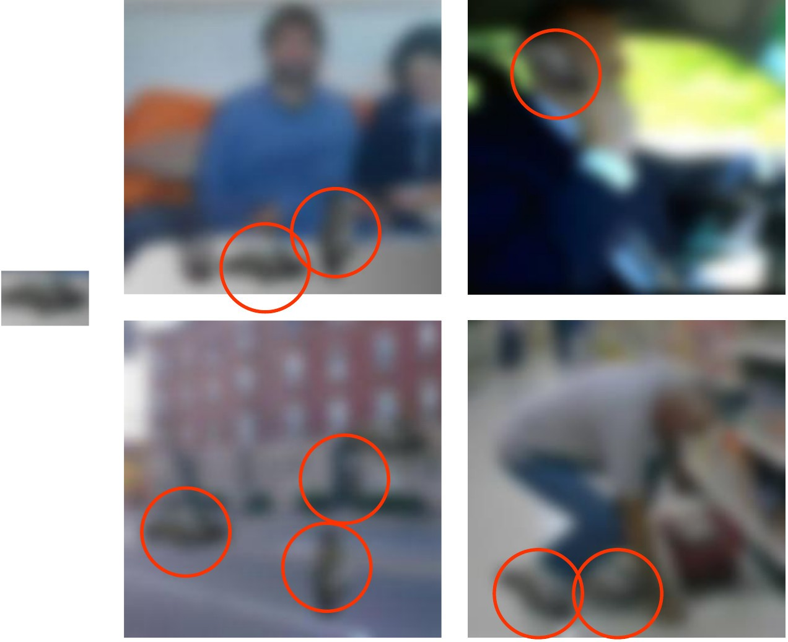
Challenges: Local Ambiguities
Image Credits: Antonio Torralba

Slide 34
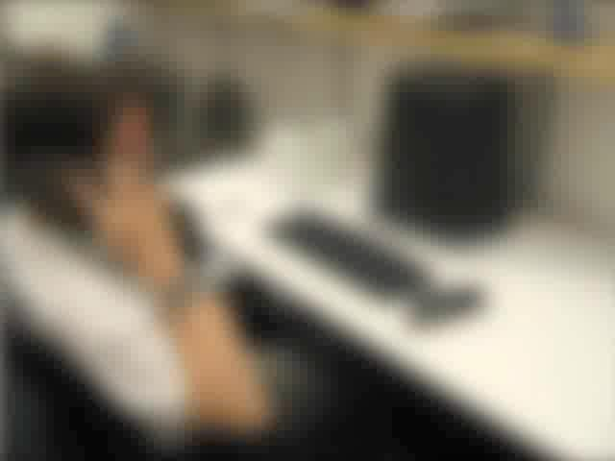
Challenges: Local Ambiguities
Image Credits: Antonio Torralba
48

Slide 35
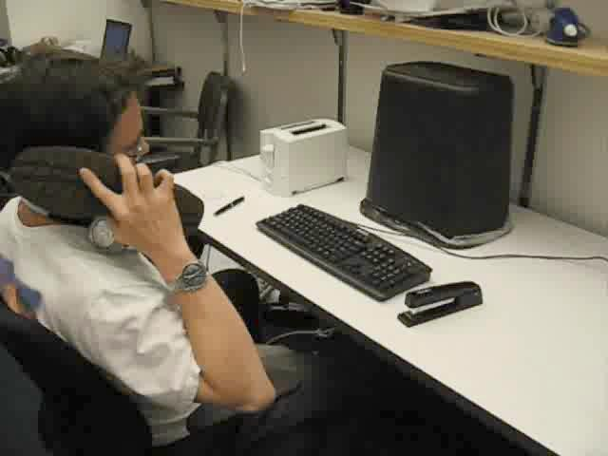
Challenges: Local Ambiguities
Image Credits: Antonio Torralba
48

Slide 36
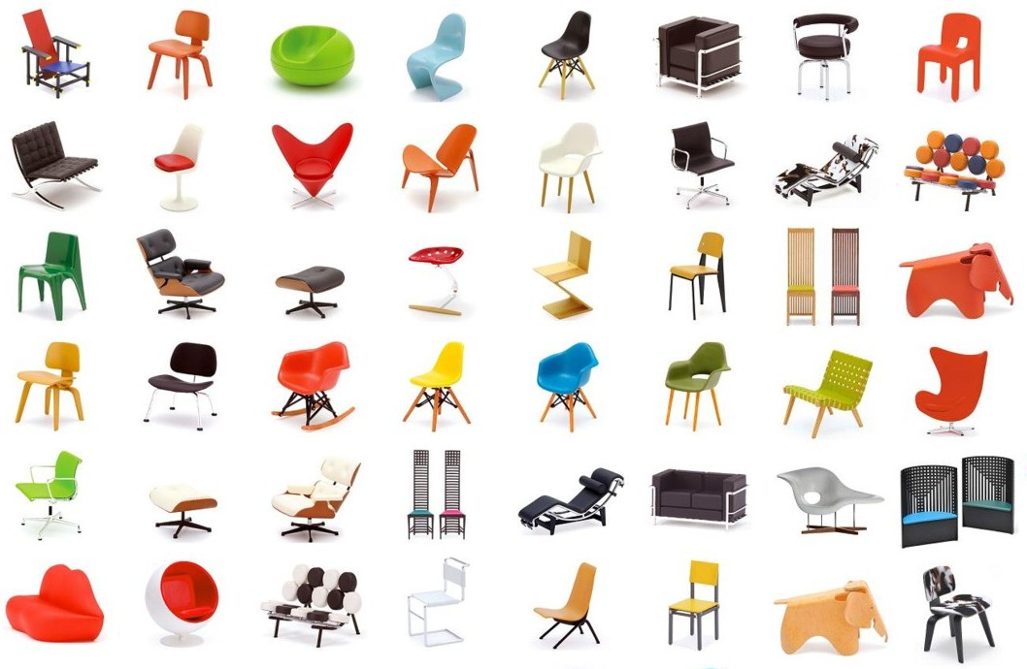
Challenges: Intra Class Variation
http://www.homeworkshop.com/
Image Credits: Antonio Torralba

Slide 37
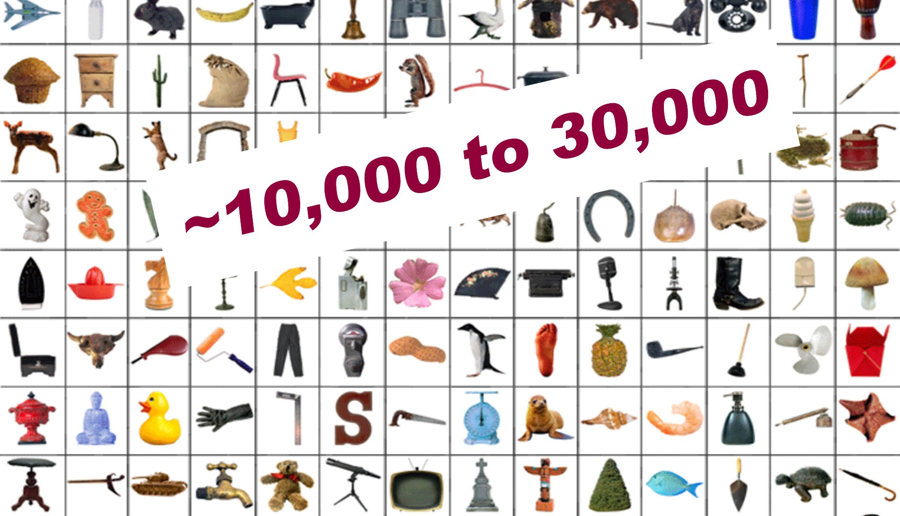
Challenges: Number of Object Categories
Image Credits: Antonio Torralba

